Slide 1
Introduction to HoloLens Development
Adrian Foster and Gry Nagel, Bouvet

Slide 2
Content
Quick introduction of the technology and toolkit
Tasks (https://github.com/grynag/booster-mr-2019 )
HoloLens demonstration

Slide 3

Software requirements
Visual Studio 2017 (Windows 10 SDK)
Unity 2018.3.x
HoloLens emulator
Mixed Reality Toolkit
Find it here: https://github.com/grynag/booster-mr-2019

Slide 4
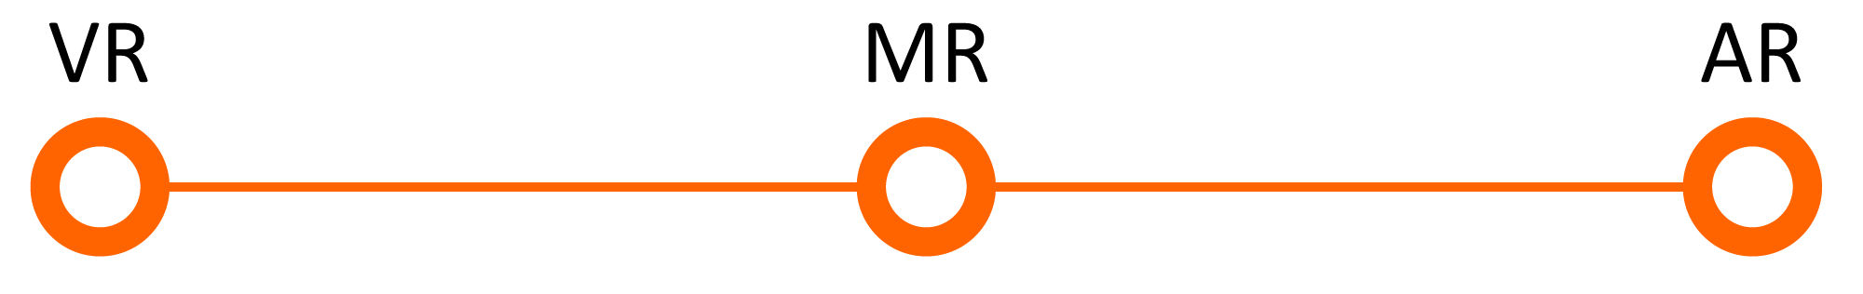
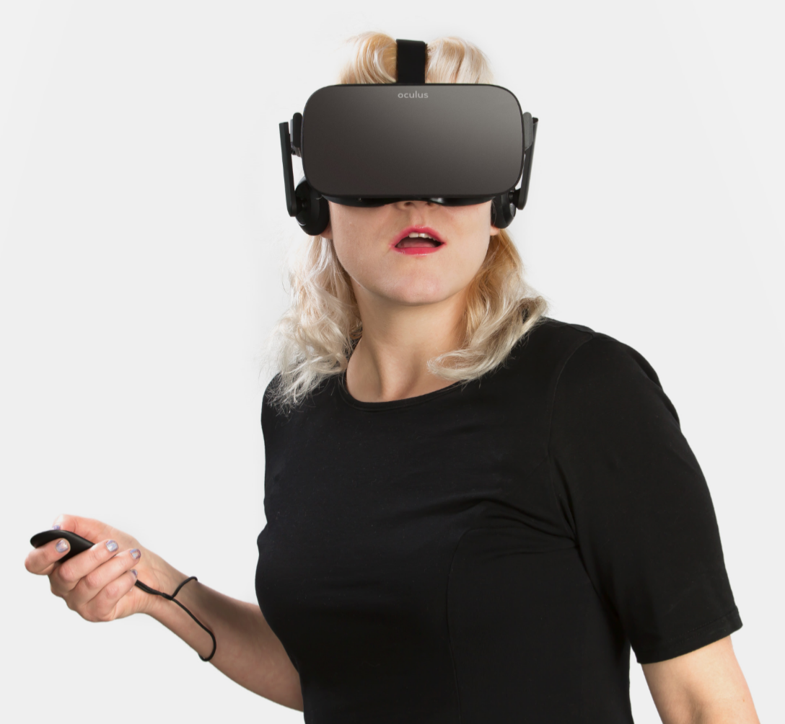
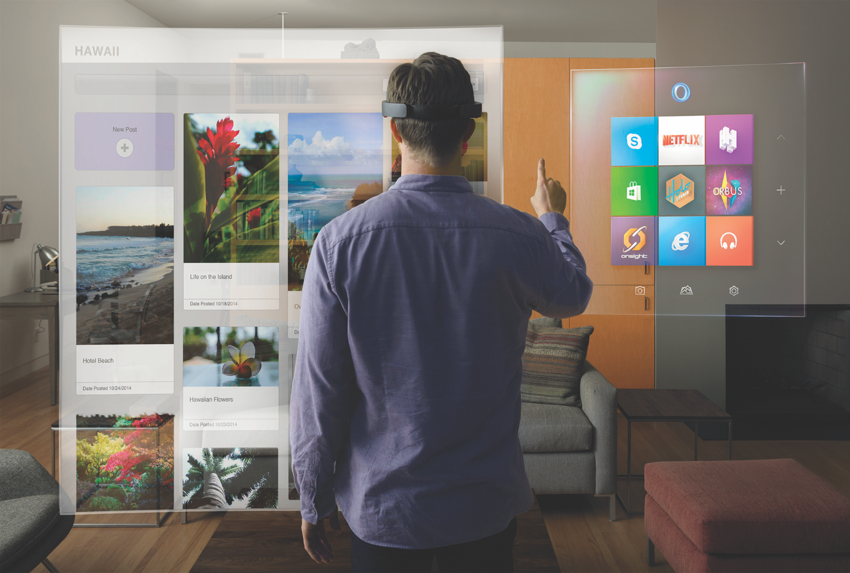
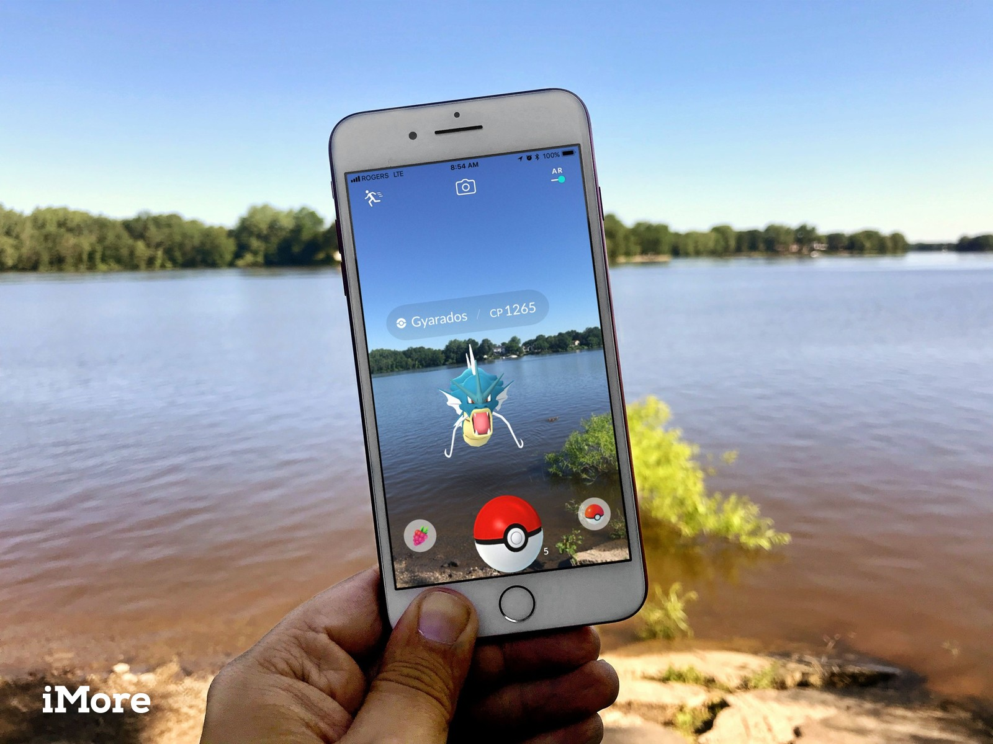
What is Mixed Reality?
Oculus materials used with permission. © 2016 Oculus VR, LLC. All Rights Reserved
Microsoft
IMore
Notes:
VR: replace
AR: add
MR: integrate

Slide 5
What is the Mixed Reality Tookit?
Collection of scripts and components
Makes the start up easier
Version 2 released October 31th 2018

Slide 6
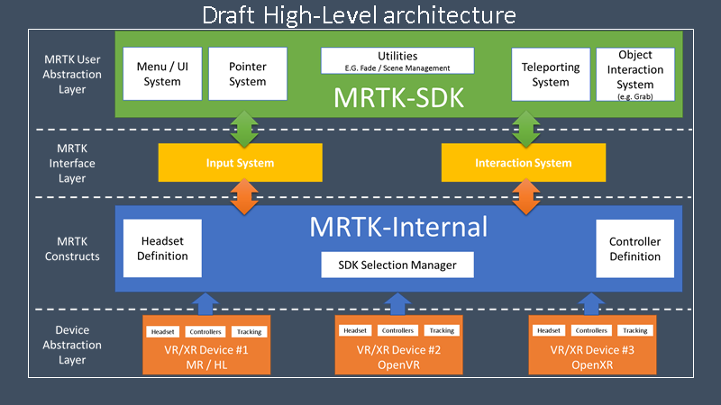
MRTK High-Level architecture
«Out of the box»
Testing
Programmatic interface
Documentation
Standardized examples
Notes:
Device Abstraction Layer
The DAL creates a bridge layer between an external provider SDK and conforms the outputs / inputs of those devices to the MRTK construct definitions. Ideally, these interfaces should be at the script level consuming the vendor SDK directly rather than relying on vendor prefab definitions.
MRTK Constructs
A coordinated set of specifications that define a generalized system for describing and interacting with multiple VR/AR platforms. The specifications detail the inner workings for the toolkit and define extendable contracts for the SDK to expose to both providers (devices) and consumers (SDK).
MRTK Interface Layer
The interface layer provides an extensible bridge to map and coordinate inputs coming from VR devices and controllers as well as providing an abstracted mechanism to output to VR systems (e.g. Haptics). It also defines preset interactions that can be composited for use by the SDK.
MRTK User Abstraction layer
This is the frontend of the entire SDK, providing pre-built components for the most used implementations for Mixed Reality. This should be provided through a set of easy to use components / scripts that can be “Drag and Dropped” to build a project. Like the Unity UI System, this does not preclude users building their own components and potentially submitting back to the project for inclusion.

Slide 7
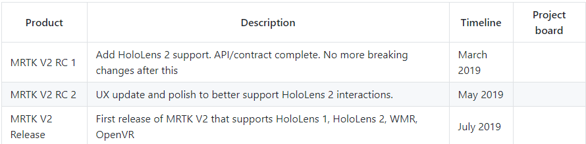
Mixed Reality Roadmap

Slide 8
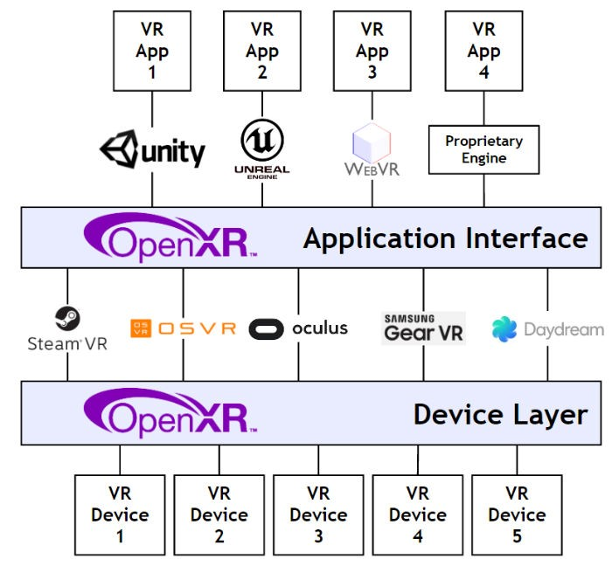
Cross-device
Notes:
https://github.com/Microsoft/MixedRealityToolkit-Unity/blob/mrtk_release/MRTK-vNext.md#open-xr-references

Slide 9
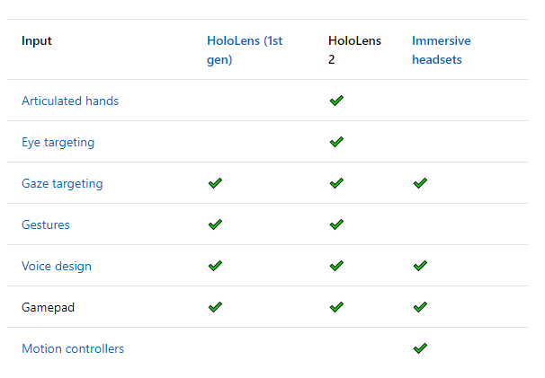
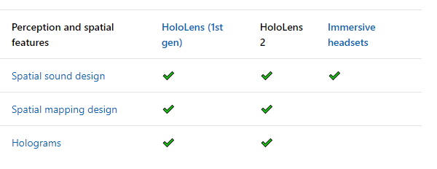
HoloLens features

Slide 10
Tasks
Create new Mixed Reality project in Unity
Adding a 3D model and using manipulation and tool tips from the MRTK
Deploying to the HoloLens emulator
Optional tasks
Tasks here: https://github.com/grynag/booster-mr-2019

